Slide 1
Improving Performance and Scalability of Algebraic Multigrid through a Specialized MATVEC and Divide and Conquer MATMULT
Majid Rasouli

Slide 2

Introduction
PhD Student in Scientific Computing in School of Computing, University of Utah
www.cs.utah.edu/~rasouli/
A member of Dr. Hari Sundar’s research team
www.cs.utah.edu/~hari/
Research Focus: Developing Saena, an Algebraic Multigrid Solver, in C++ (MPI + OpenMP)
Put Saena’s homepage here.

Slide 3

Introduction
Approximate solution $x$ of a linear system:
$$Ax=b$$
such that $A∈ℝ^{n×n} is sparse, x and b∈ℝ^{n}$.
Lower Levels of Multigrid => Loss of Sparsity (Fill-in) => More Communication
Matrix-Vector product (MATVEC): the dominant operation in algebraic multigrid, especially in the solve phase.
Matrix-Matrix product (MATMULT): the dominant operation in the setup phase.
Our goal is to improve these two operations.

Slide 4
Matrix-Vector Product (MATVEC)

Slide 5
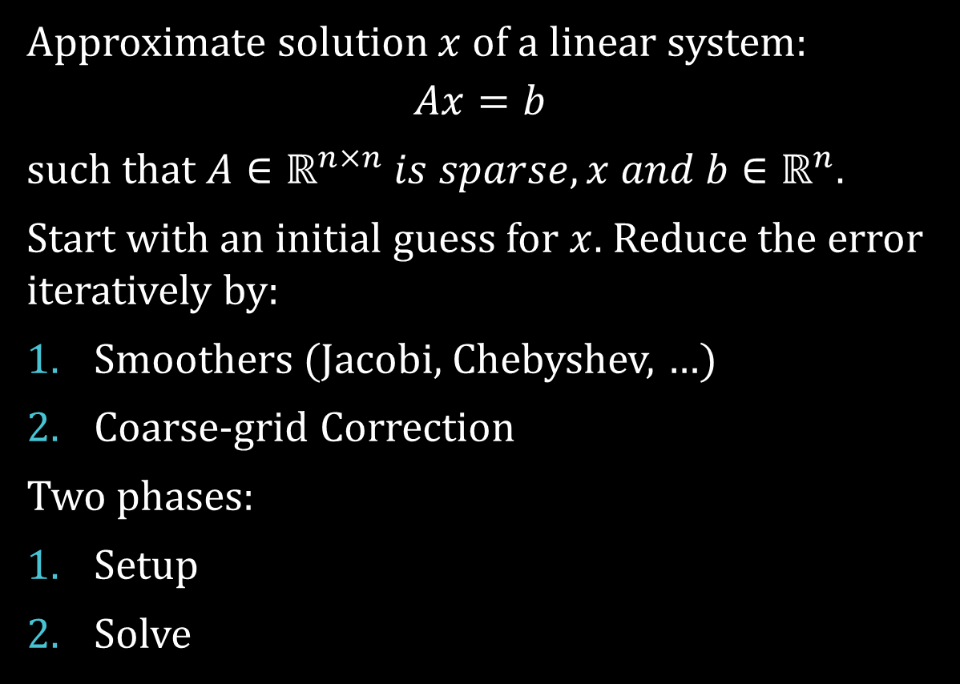
Algebraic Multigrid
Approximate solution $x$ of a linear system:
$$Ax=b$$
such that $A∈ℝ^{n×n} is sparse, x and b∈ℝ^{n}$.
Start with an initial guess for $x$. Reduce the error iteratively by:
Smoothers (Jacobi, Chebyshev, …)
Coarse-grid Correction
Two phases:
Setup
Solve

Slide 6


Setup phase: two-grid
coarsening
$$A_{coarse}=R×A×P$$
$R$: restriction, $P$: prolongation
$$A_{coarse}$$
R
A
P

Slide 7

Setup phase: multigrid
$$As\left[l+1\right]=Rs\left[l\right]×As\left[l\right]×Ps\left[l\right]$$
$As\left[0\right]$ is the finest matrix $A$.
As: coarse matrices
$Rs$: restriction matrices
$Ps$: prolongation matrices

Slide 8
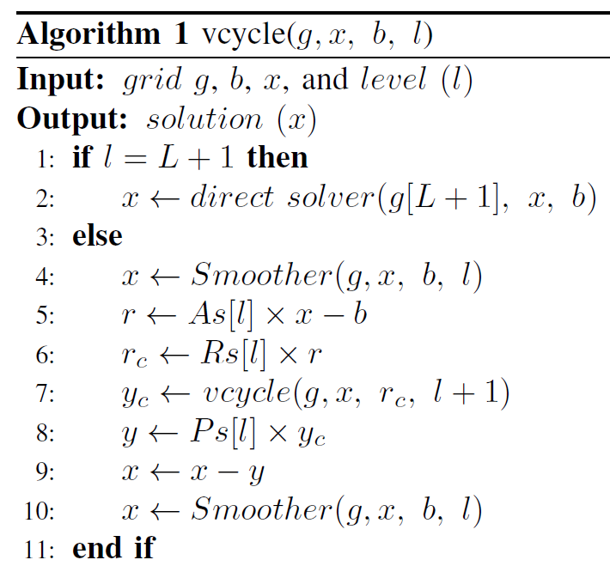
Solve phase:
MATVEC

Slide 9
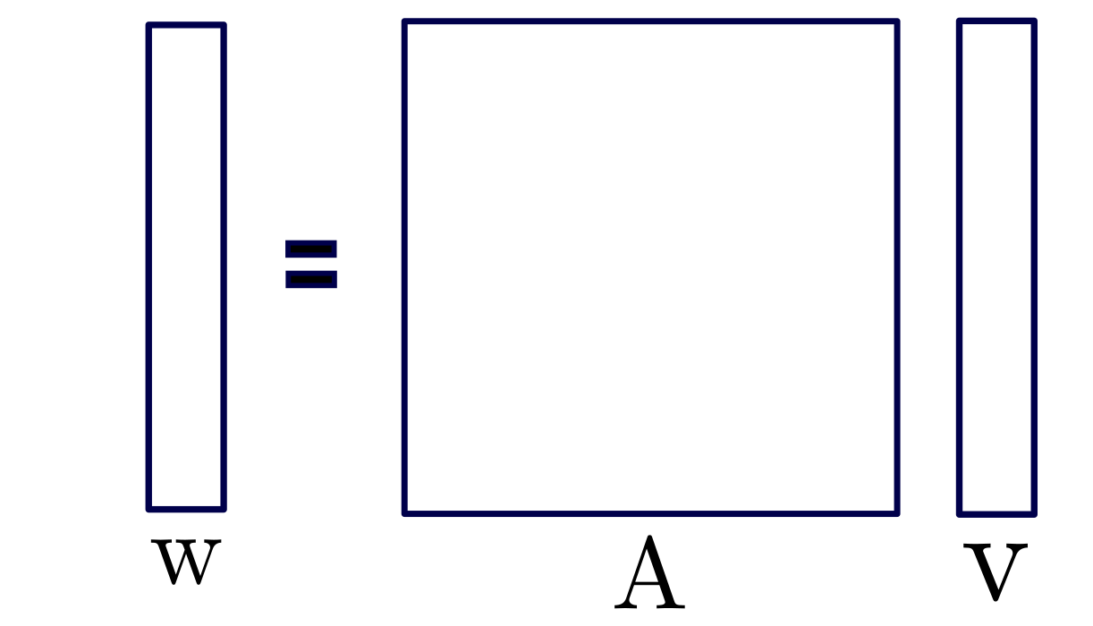
MATVEC

Slide 10
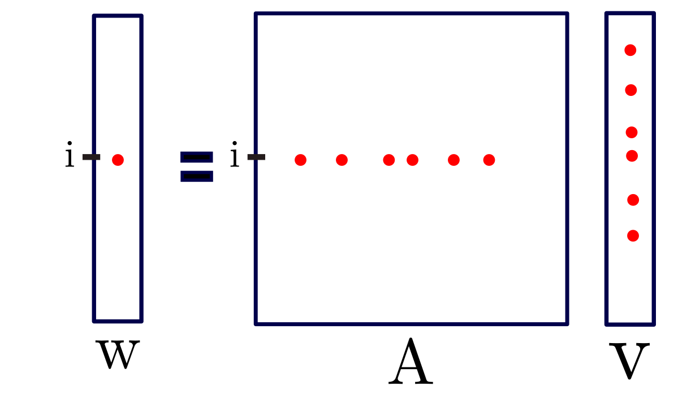
MATVEC

Slide 11
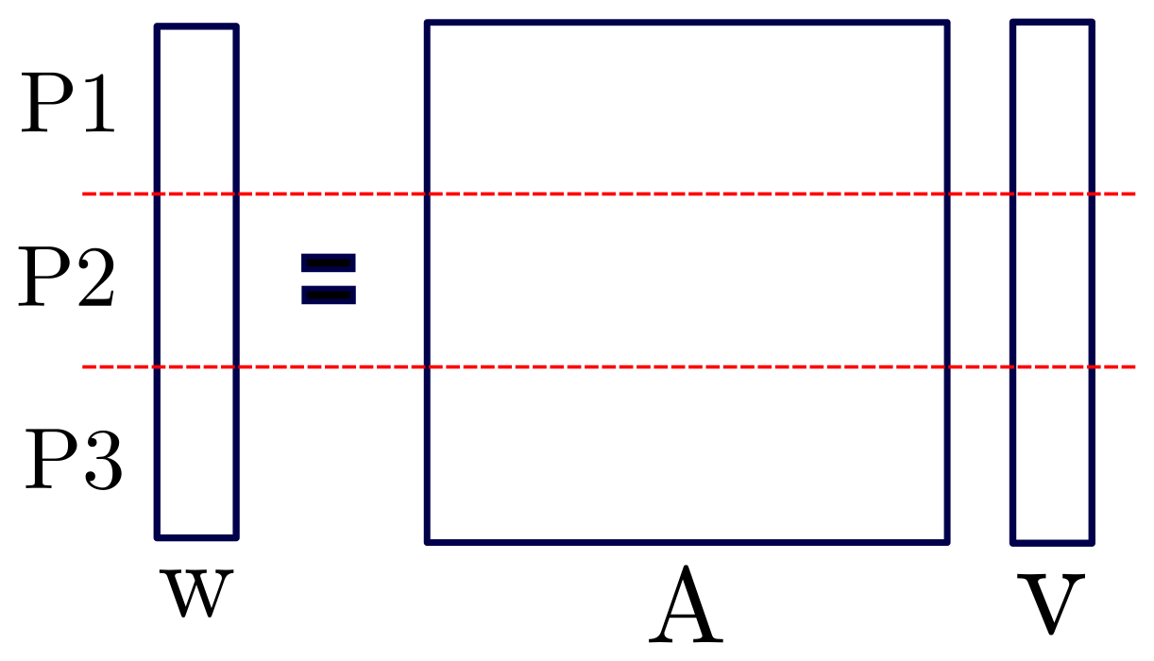
Distributed MATVEC

Slide 12
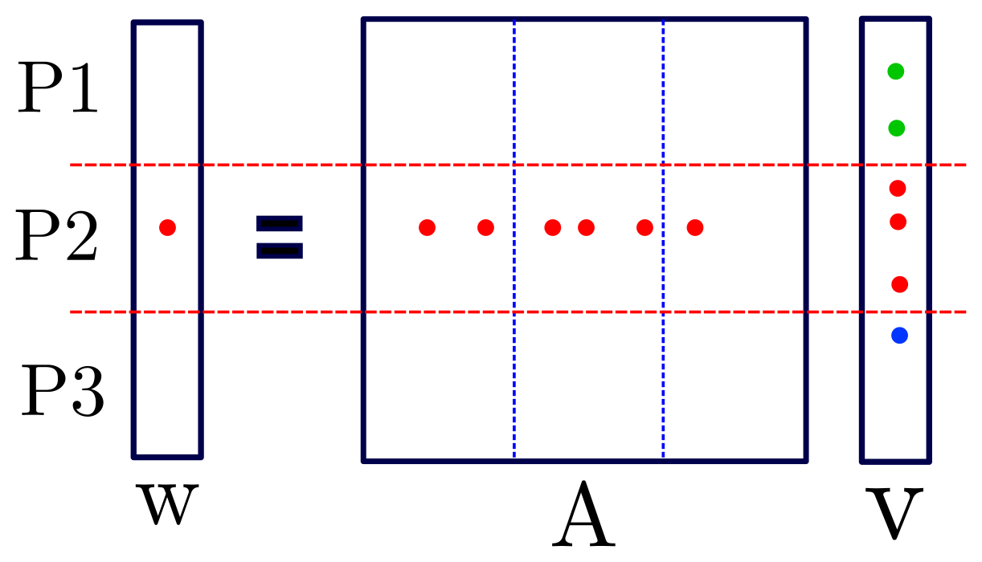
Distributed MATVEC

Slide 13
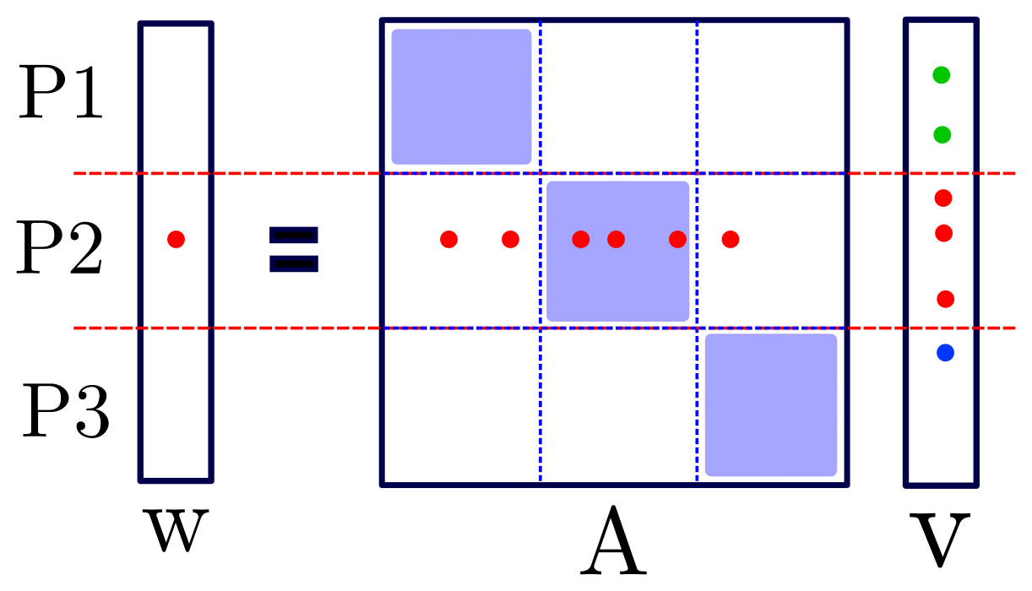
Distributed MATVEC
Local loop
Communication
Remote loop
Notes:
Now I’m gonna show you where we the issue is.

Slide 14

Problem
$$A_{coarse}$$
R
A
P

Slide 15
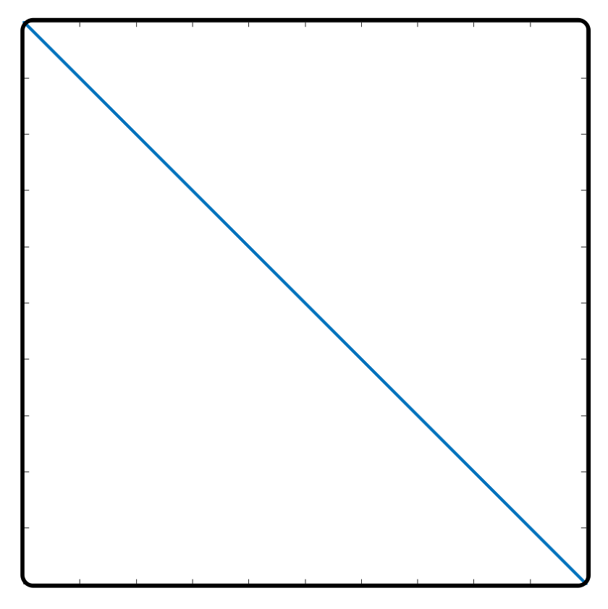
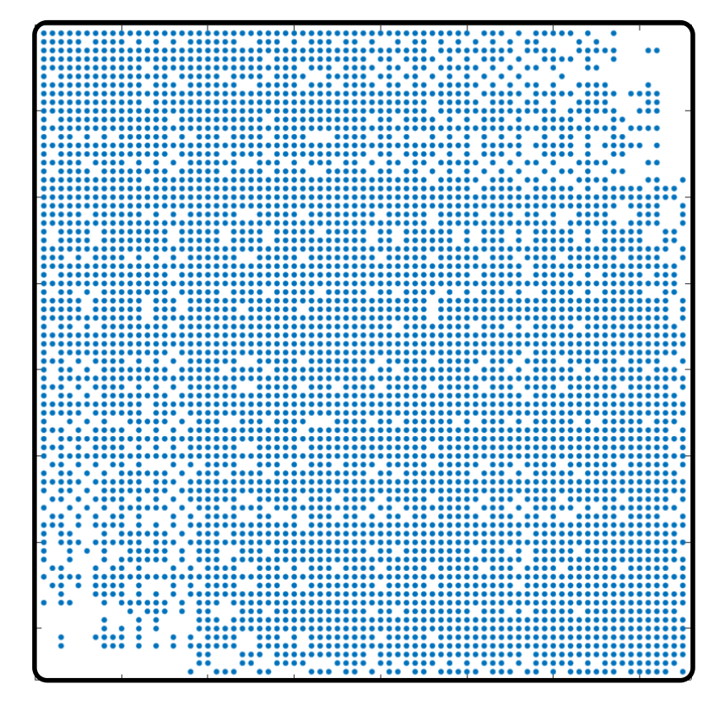
Problem
Florida Matrix Collection: ecology2
Left: input matrix, right: level 5

Slide 16
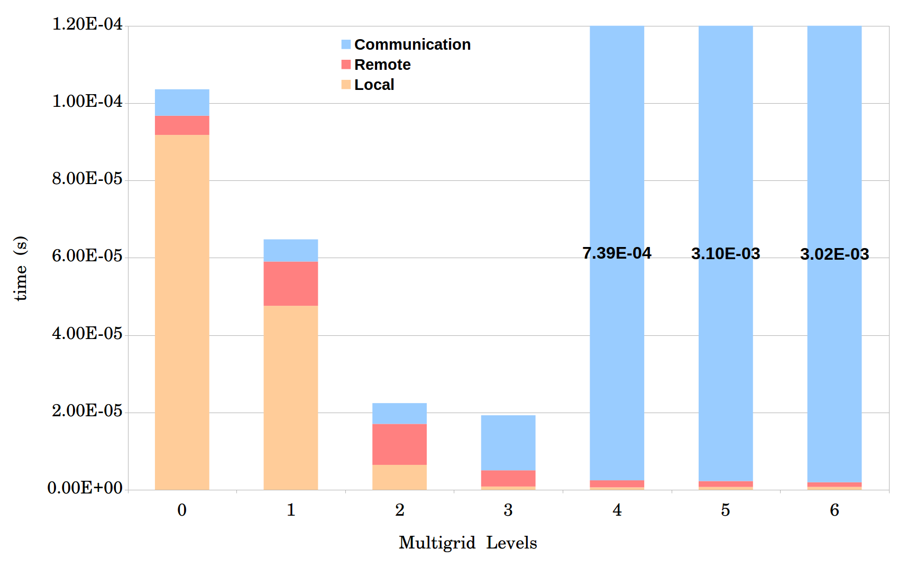
Problem
Average time for one MATVEC
Matrix ID 1883 from Florida Matrix Collection
On 1008 processors

Slide 17
Improving MATVEC
Optimized in both shared memory and distributed memory aspects.
Process Shrinking
Local MATVEC
Load-balance
Dense MATVEC

Slide 18
I. Process Shrinking
More Computing Power
More Processors
More Communication
How: Dummy MATVEC when creating coarse matrices.
When: If the communication time becomes significantly higher than local and remote loops.

Slide 19
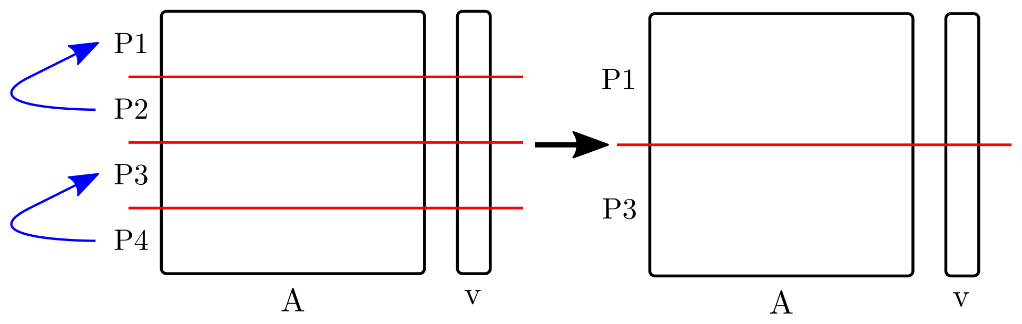
I. Process Shrinking
Simple version:
Advanced version:
There is a load-balance function for each level of multigrid.
Combine process shrinking with the load-balance function.

Slide 20
I. Process Shrinking
Average time for one MATVEC
Matrix ID 1883 from Florida Matrix Collection
On 1008 processors

Slide 21
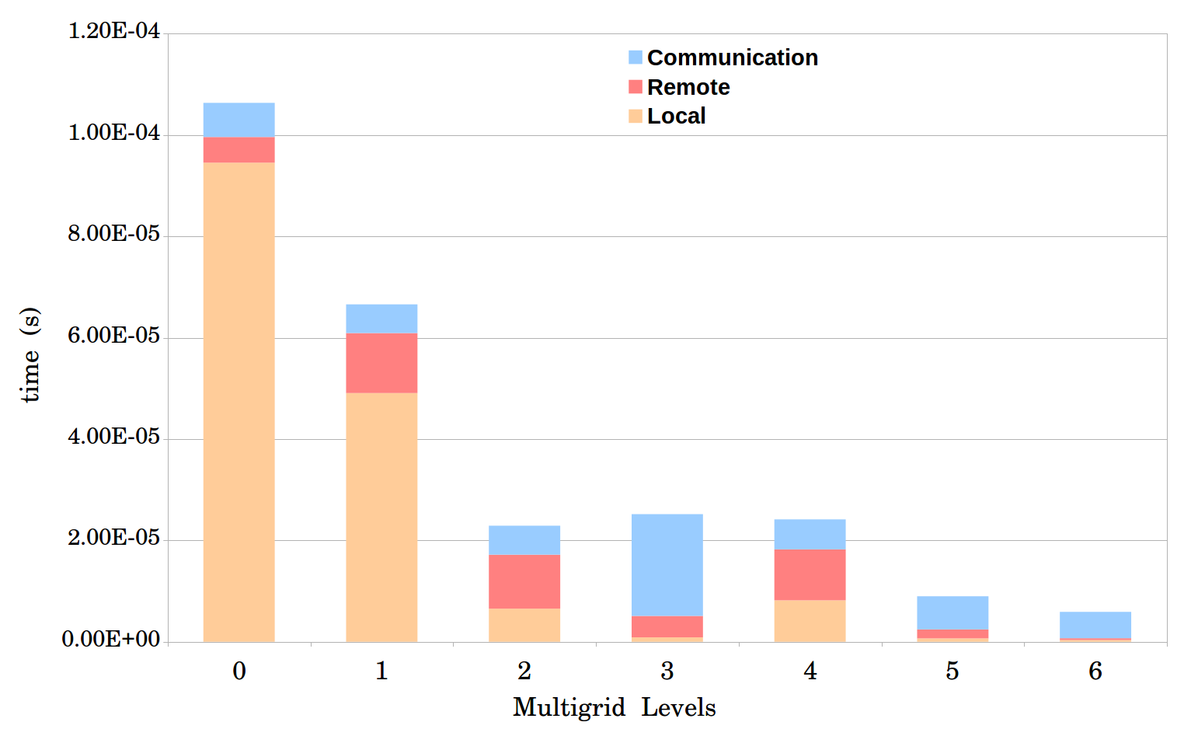
I. Process Shrinking
Notes:
Next step is improving local and remote loops.

Slide 22
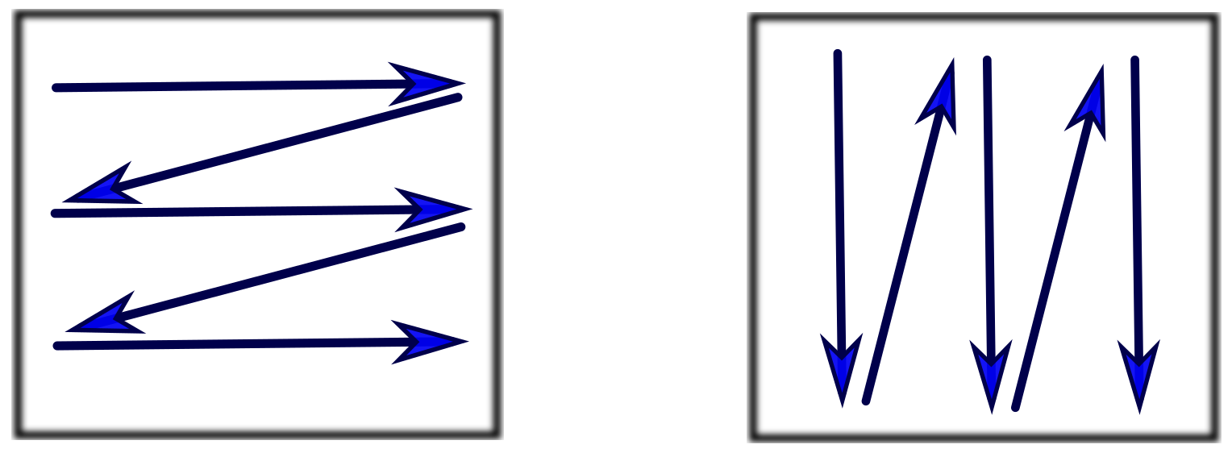
II. Local MATVEC
Shared memory optimization.
OpenMP: Using multiple threads for computations.
Column-Major
Row-Major
Staggered Row-Major
Column-Major with optimized reduction

Slide 23
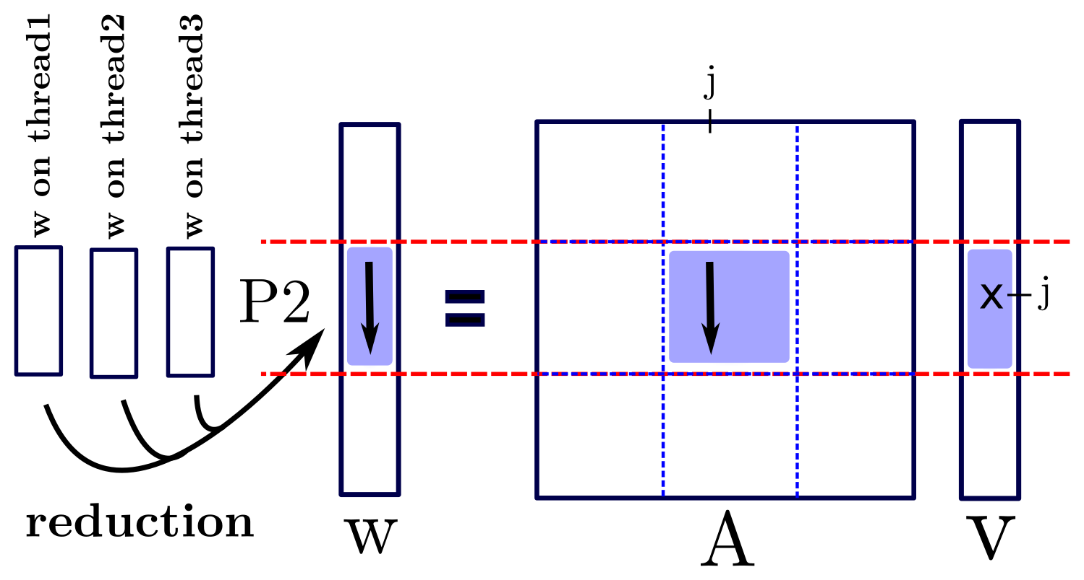
II. Local MATVEC
I. Column-Major:

Slide 24
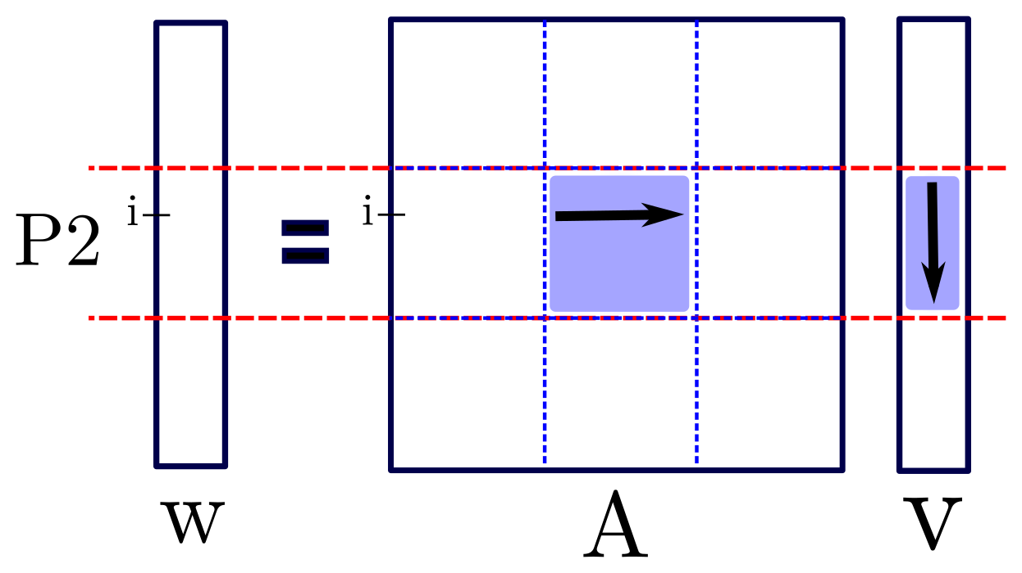
II. Local MATVEC
II. Row-Major:

Slide 25
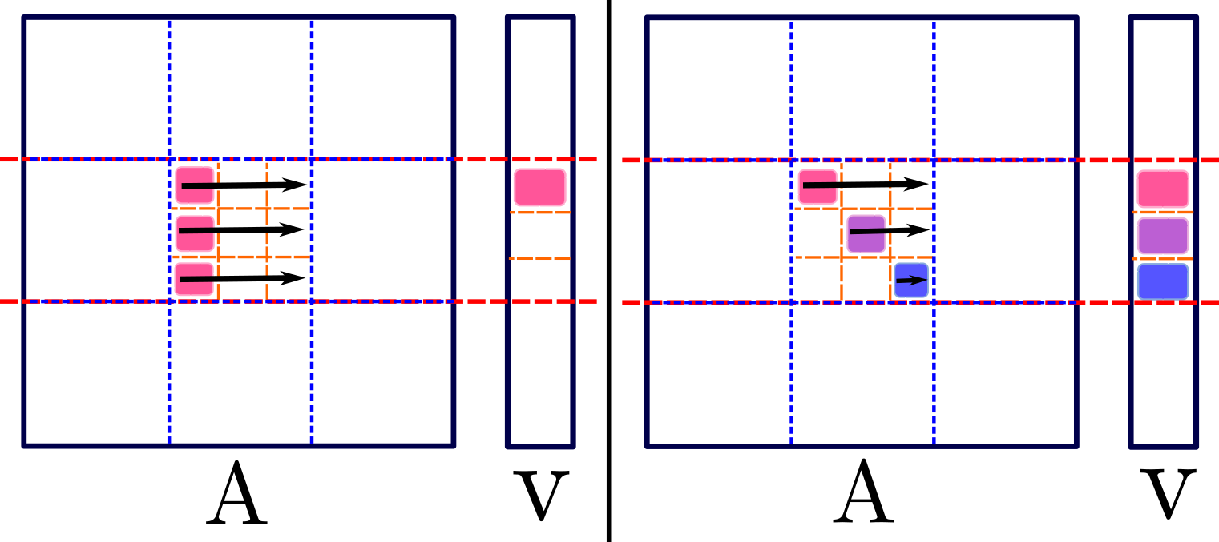
II. Local MATVEC
III. Staggered Row-Major:

Slide 26
II. Local MATVEC
IV. Column-Major with optimized reduction

Slide 27
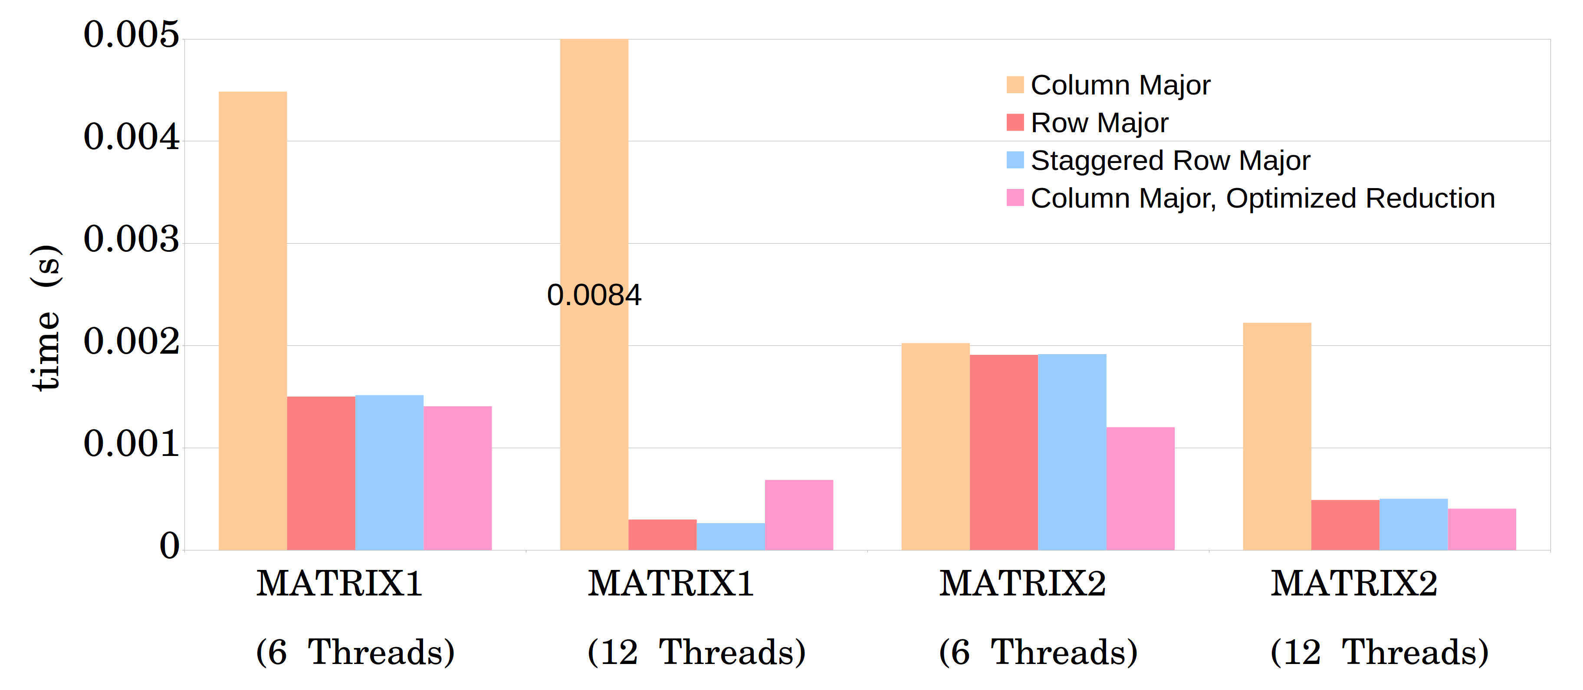
II. Local MATVEC
384 cores, 32 MPI tasks.

Slide 28
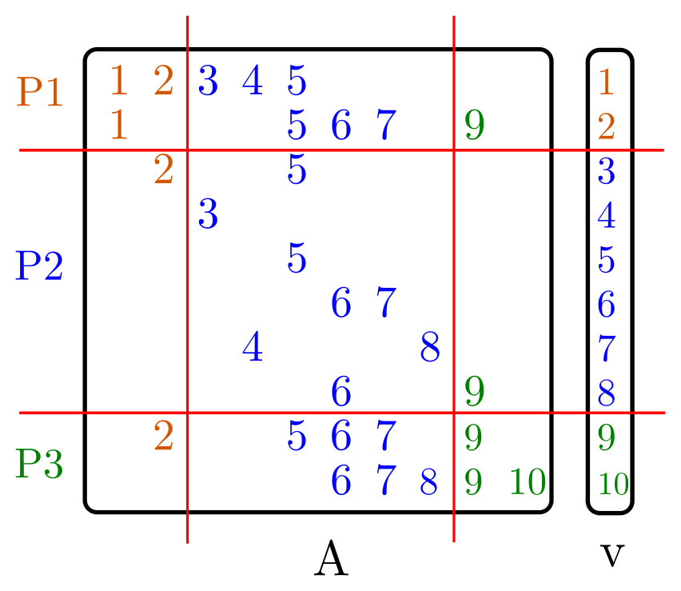
III. Load-balance

Slide 29
III. Load-balance
Load-balance based on:
Number of non-zeros (euqi-NNZ)
Number of rows (equi-row)

Slide 30
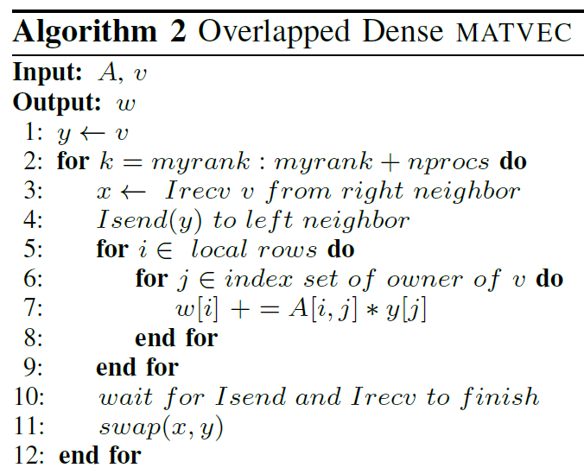
IV. Dense MATVEC

Slide 31
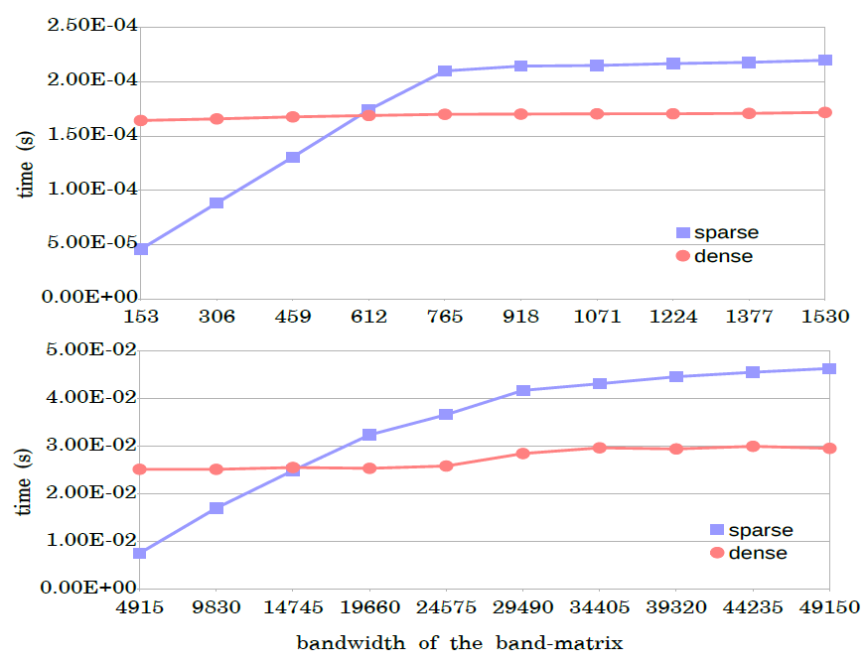
IV. Dense MATVEC

Slide 32
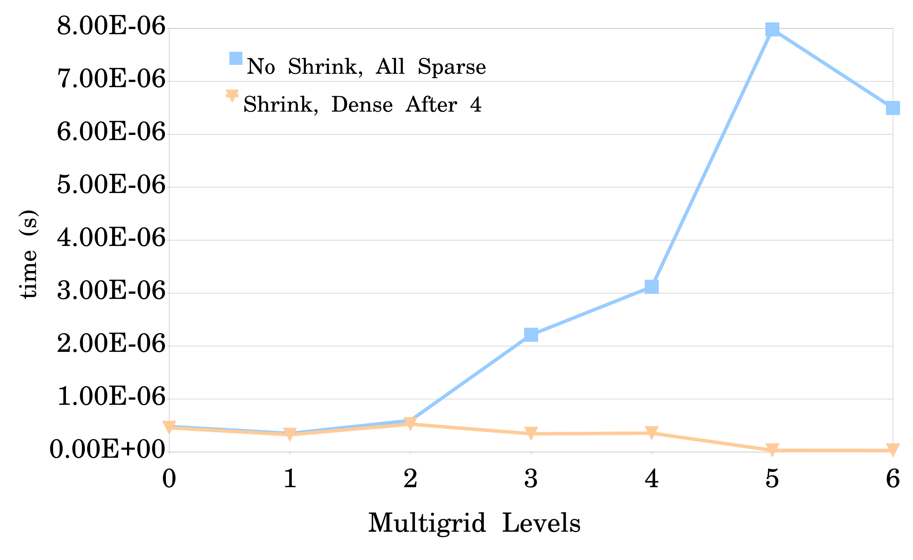
Results
Average time for one MATVEC.
Matrix ID 1883 from Florida Matrix Collection
On 1728 processors

Slide 33
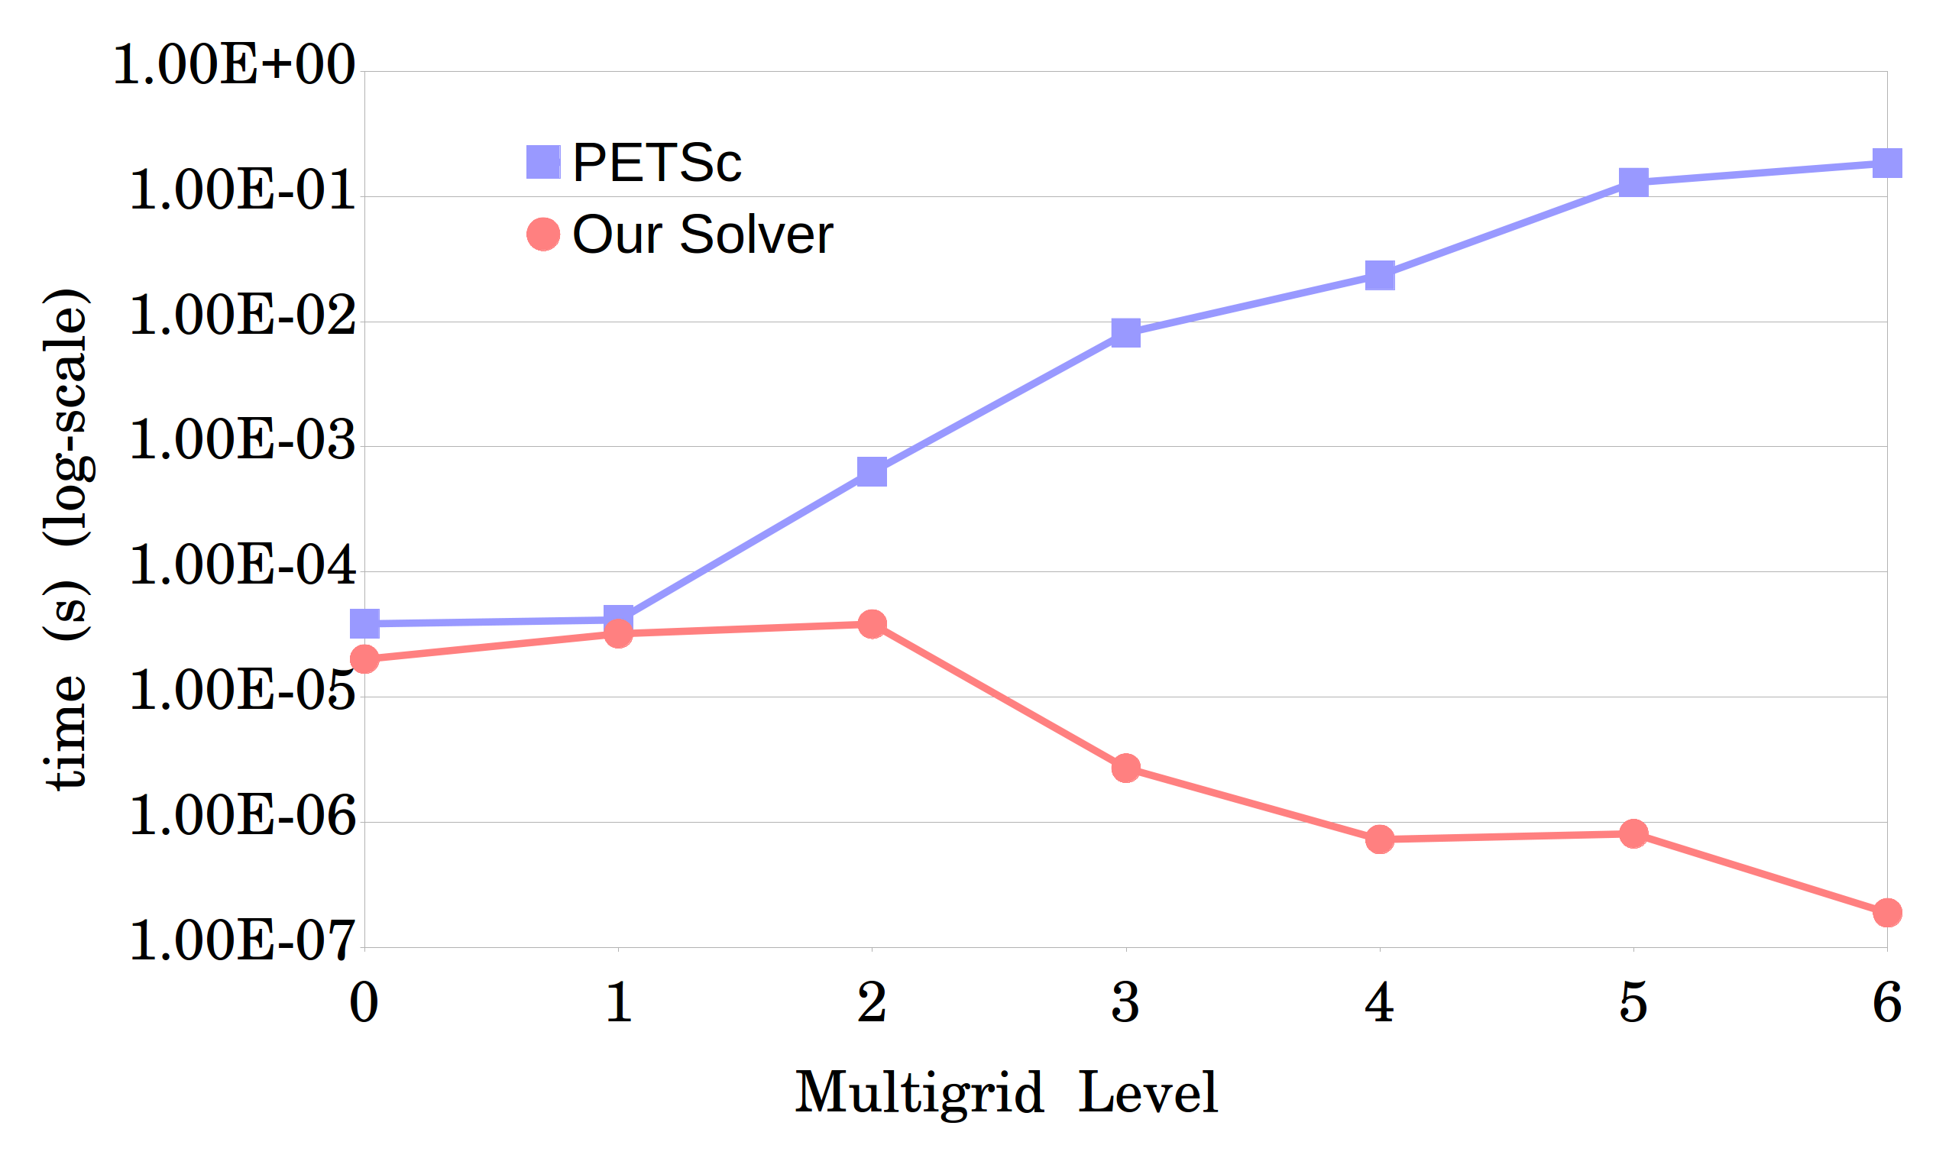
Results
Average time for one MATVEC.
Matrix ID 1883 from Florida Matrix Collection
On 1008 processors

Slide 34
Acknowledgement
Many thanks to my adviser, Dr. Hari Sundar, for his generous help.
This work was supported in part by:
NSF: ACI-1464244, CCF-1643056
Army Research Office: W911NF1510222
And also used resources of:
XSEDE: TG-PHY180002

Slide 35
Matrix-Matrix Product (MATMULT)

Slide 36
Idea
(convert this to bullet points)
We design a divide and conquer approach to perform the sparse MATMULT in a node-local fashion. The key idea is to perform simple tasks while recursing, having efficient memory access, and to perform the multiplication for small chunks where the resulting matrix can fit into an appropriate cache. For clarity of presentation, we assume that the data is available locally and discuss it as a serial implementation. We split the matrices recursively in two ways: split by half based on the matrix size and based on number of nonzeros. First we explain the algorithms performing splitting based on the matrix sizes.

Slide 37
Recursive MATMULT
(Add a figure to explain how we split matrices.)
Case 1: Stop the recursion: perform the multiplication.
Case 2: A is horizontal.
Case 3: A is vertical.

Slide 38
Case1: Threshold
To decide when to stop the splitting process and perform the multiplication, instead of using row and column size of sub-matrices, we use nonzero rows and columns, (use an image to show why).
NNZ_MAT_SIZE = A_nnz_row * B_nnz_col
A_nnz_row = nonzero rows of A
B_nnz_col = nonzero columns of B
NNZ_MAT_SIZE < 20M => Perform Multiplication

Slide 39
Case1: Methods
Dense: A Dense matrix used as buffer of size NNZ_MAT_SIZE.
Before starting MATMULT, a memory block of size of the threshold is allocated.
Hashmap: (index, value).
If the entry is available, add the new value to it, otherwise add a new entry.
Notes:
Explain when each one is better

Slide 40
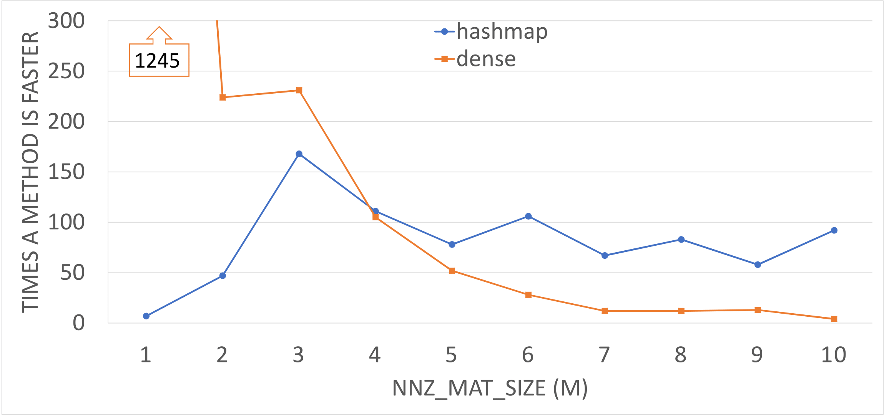

Case1
Comparison for between dense structure method with hashmap to compute coarse matrix $Ac = R×A×P$ in which A is the 3D Poisson problem of size 216k. The plot shows the number of times each method is faster than the other one in intervals of 1M for NNZ_MAT_SIZE.

Slide 41
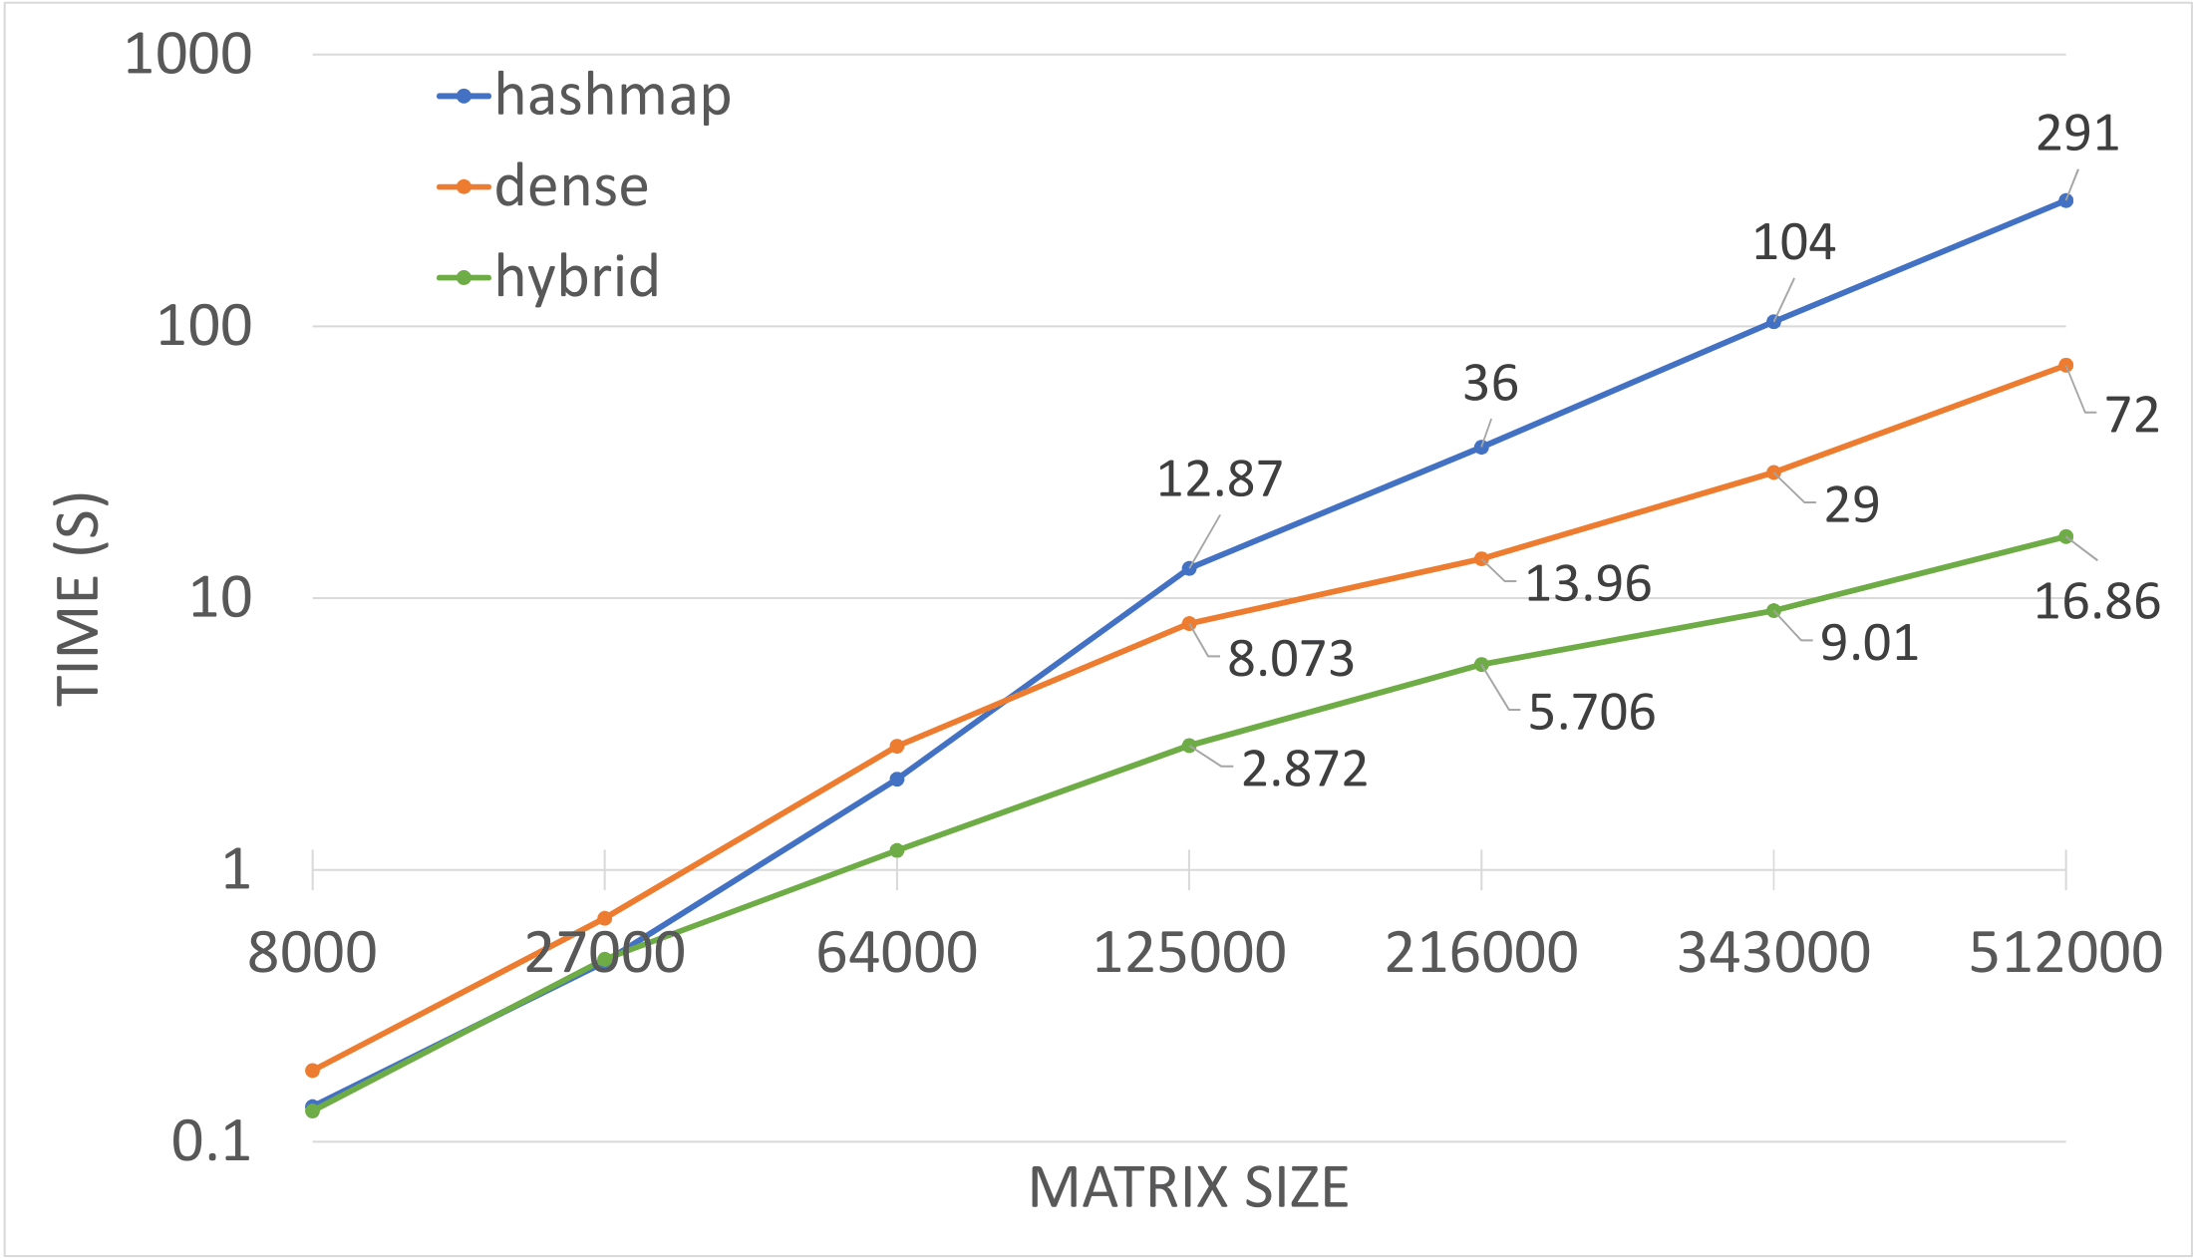
Case1
Compute the coarse matrix (the triple multiplication) on 7 matrices (3D-Poisson) of different sizes.

Slide 42
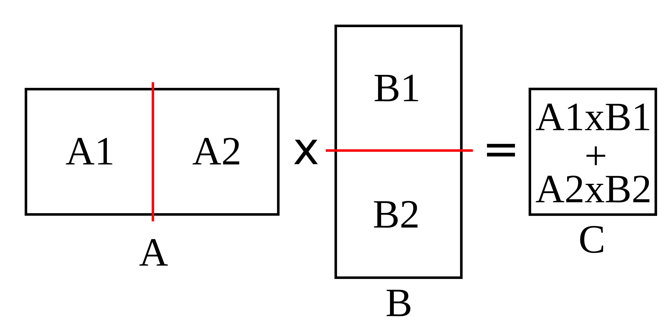
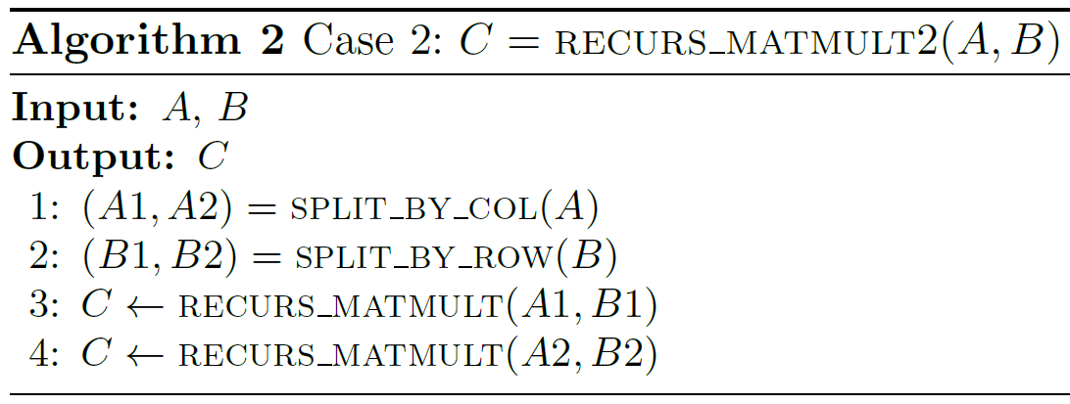
Case2
When A is horizontal.
Notes:
When A is horizontal, we halve A by column based on its column size. Since row size of B equals column size of A, we halve B by row, so it will be a split similar to A, but horizontally.

Slide 43
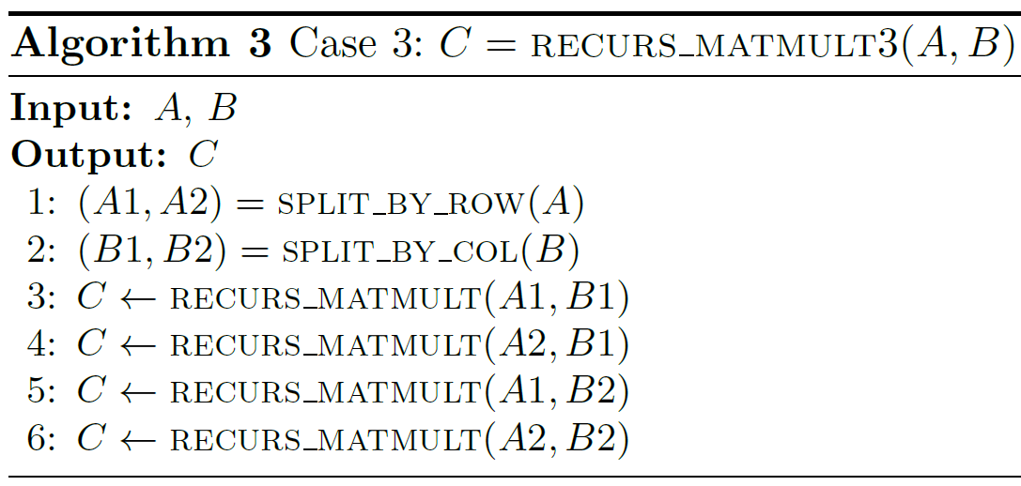
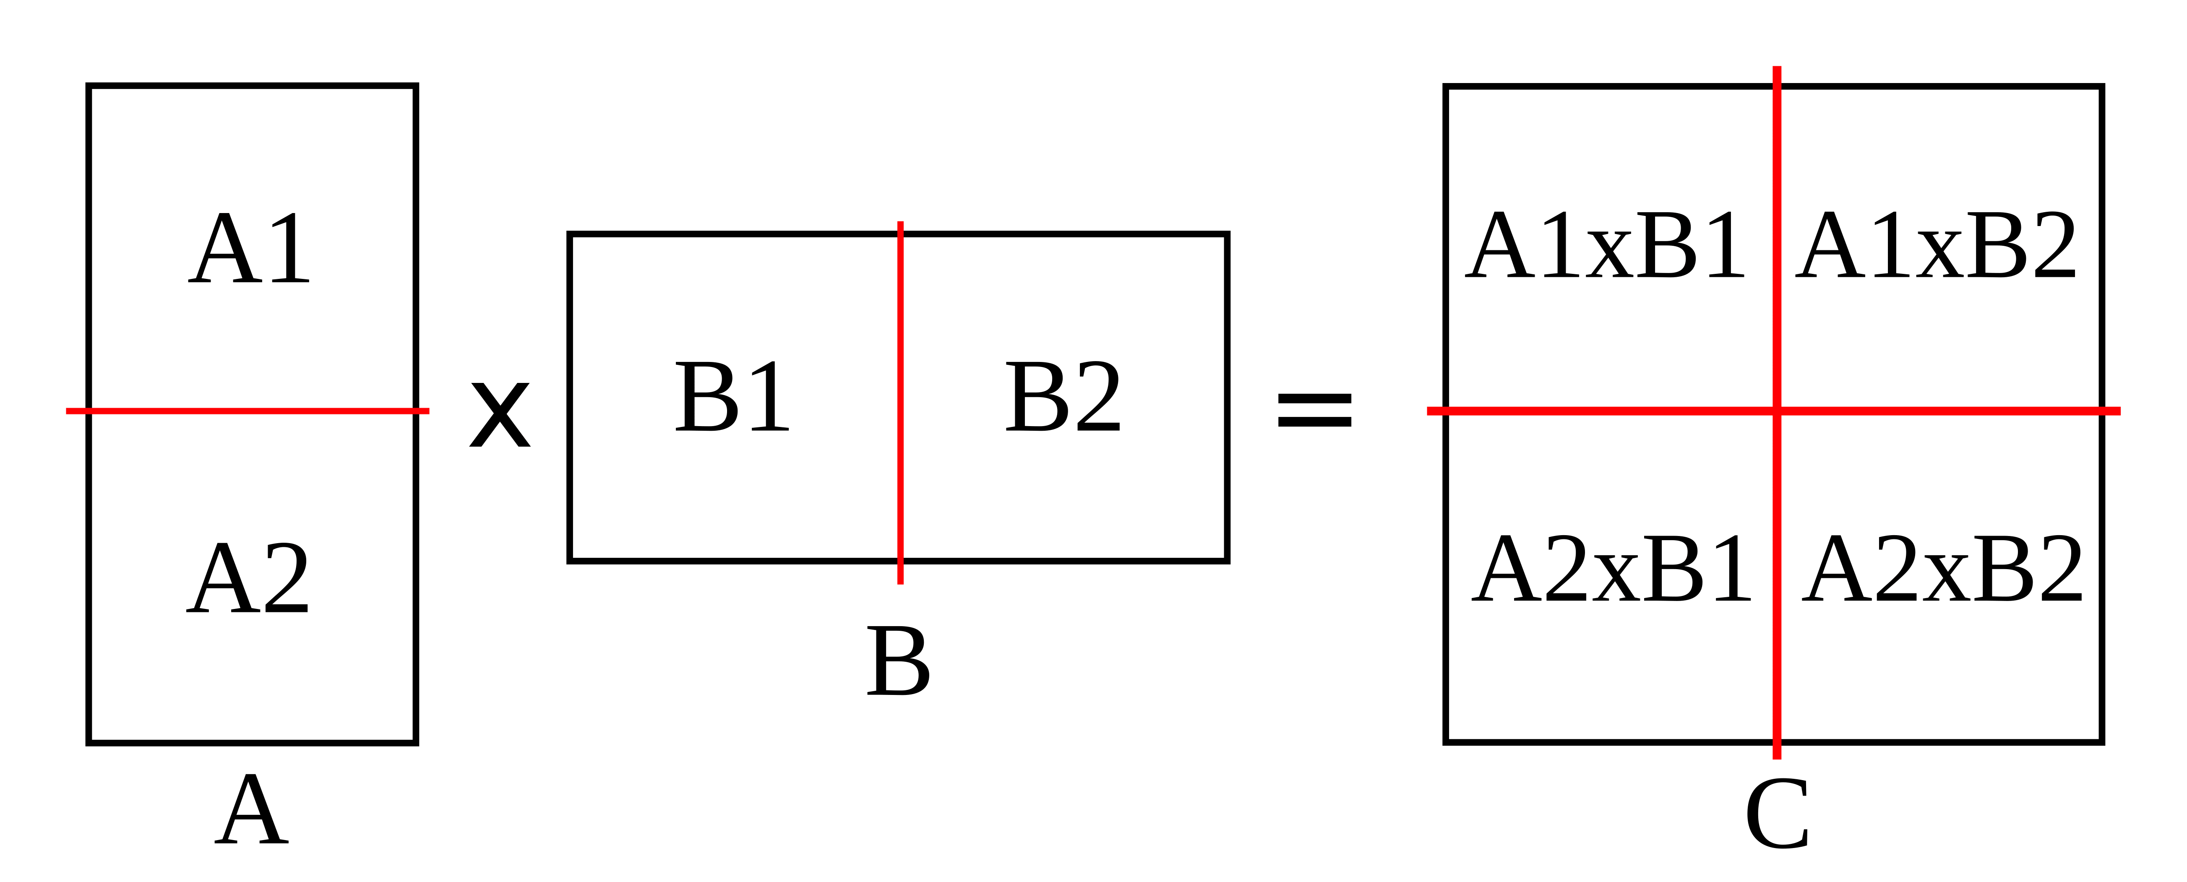
Case3
When A is vertical.

Slide 44
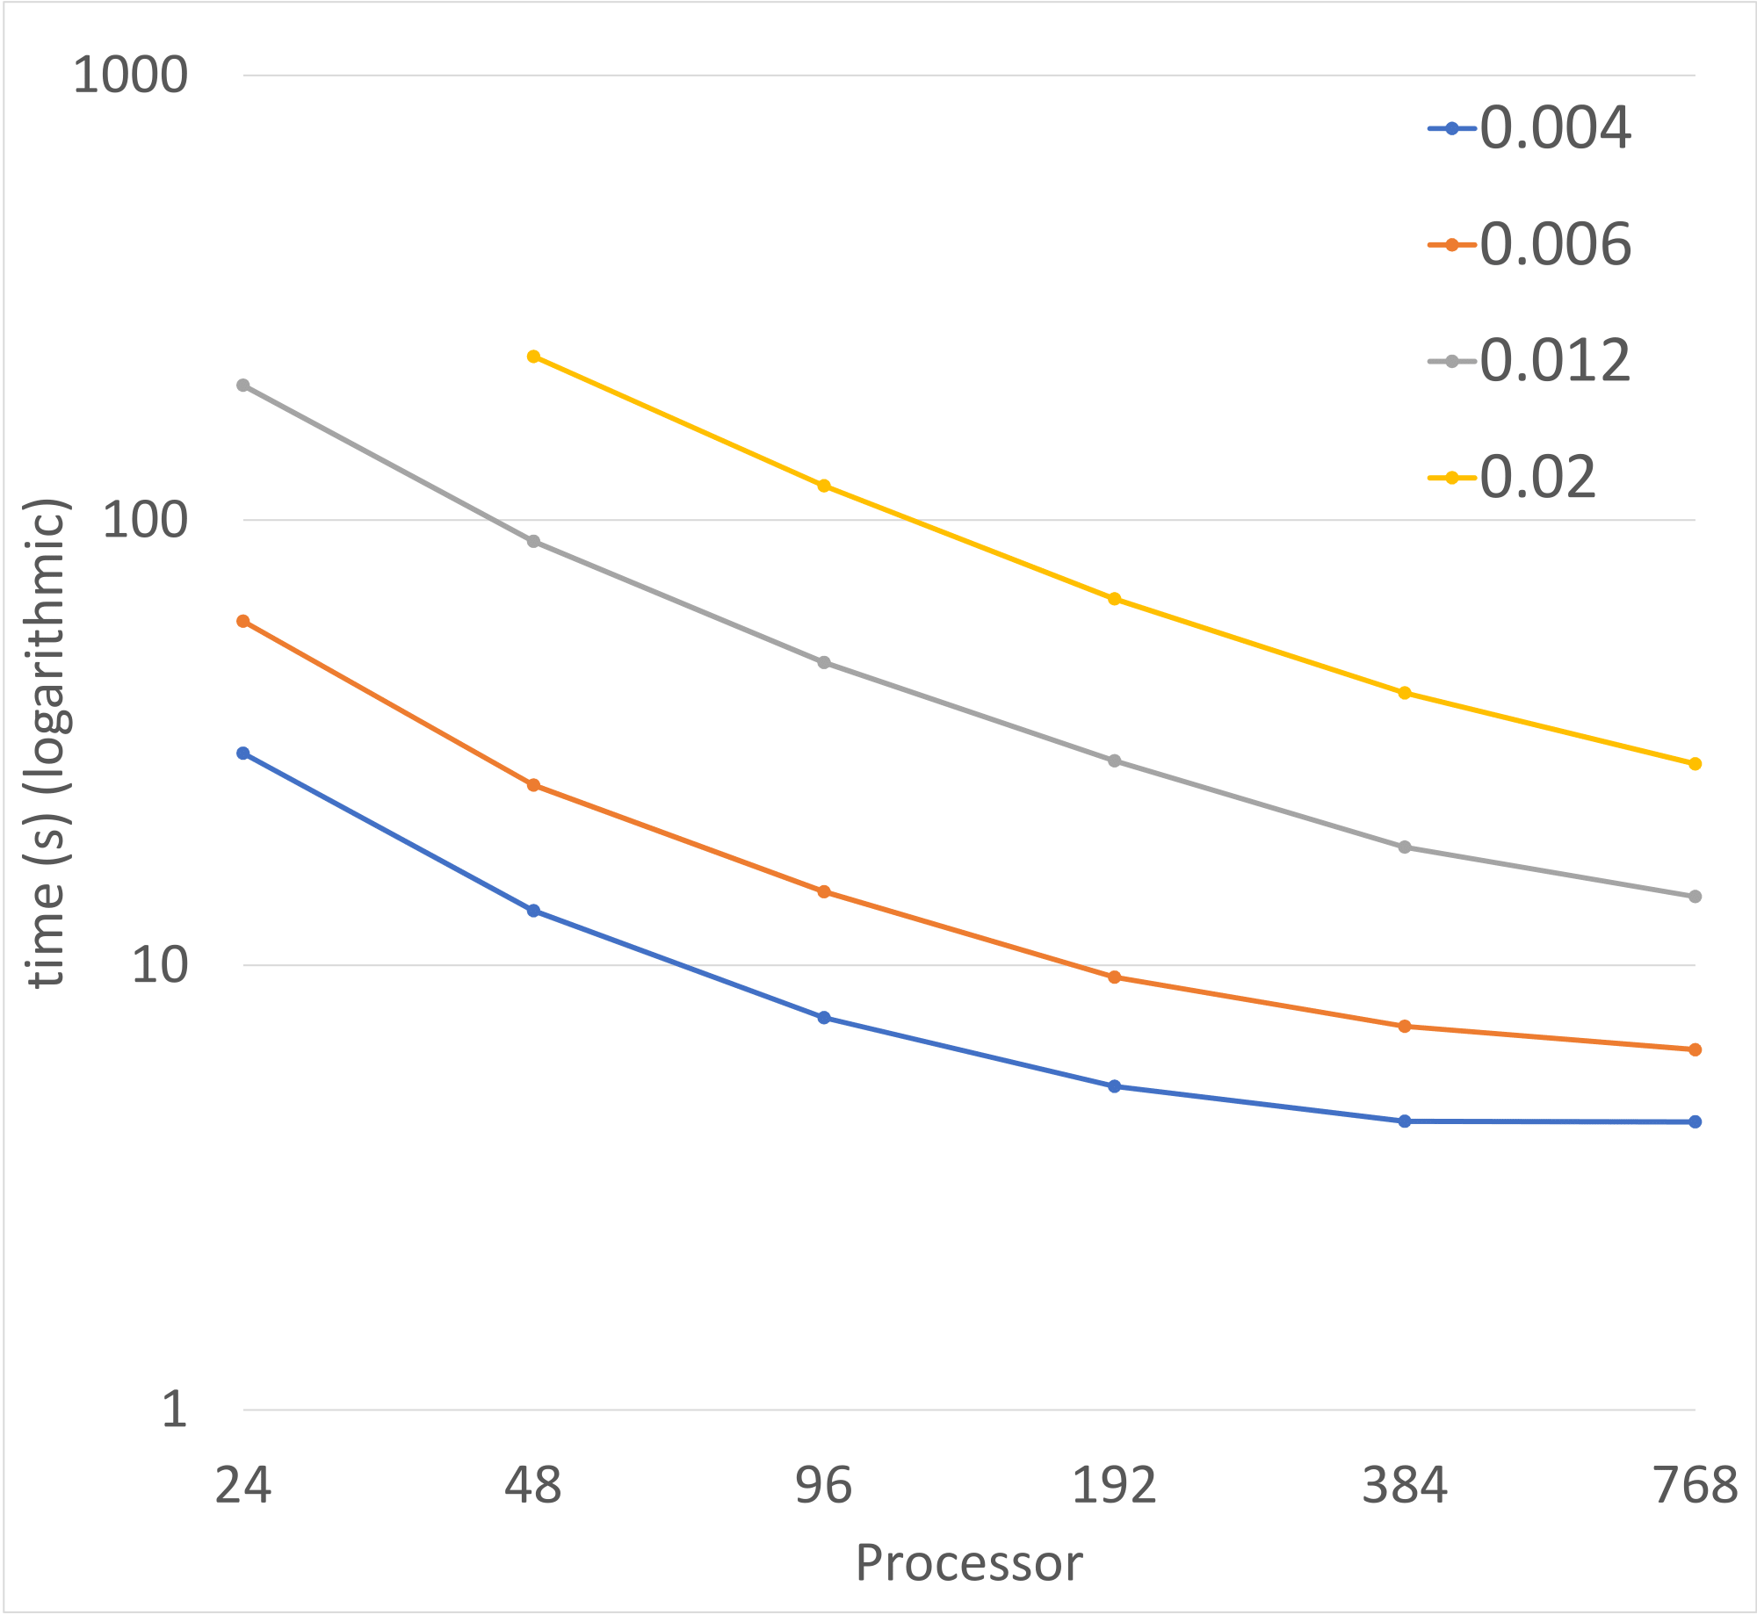

Results
Strong scaling of MATMULT for 4 banded matrices of the same size (192k), but with different bandwidth. Split based on size.
Legend: $density=\frac{nonzero}{{size}^{2}}$

Slide 45
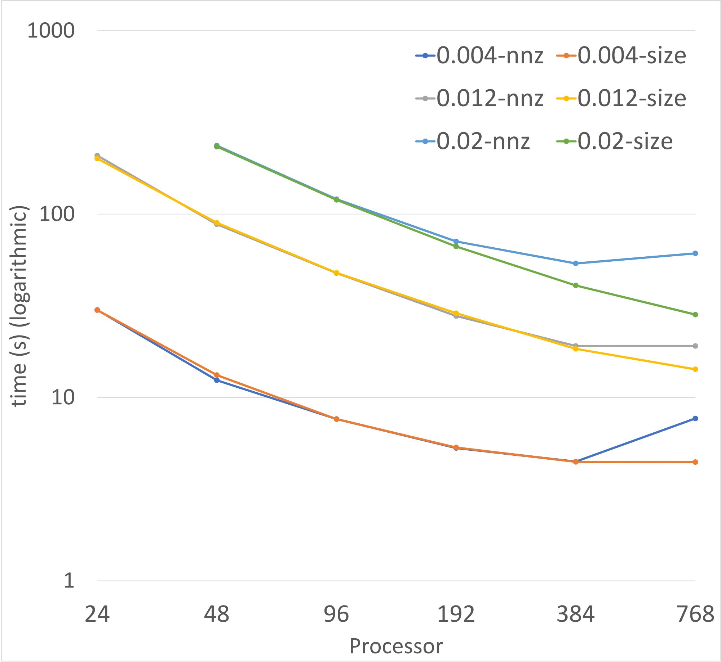

Results
Comparing split based on size vs. split based on nonzero.
Legend: $density=\frac{nonzero}{{size}^{2}}$

Slide 46
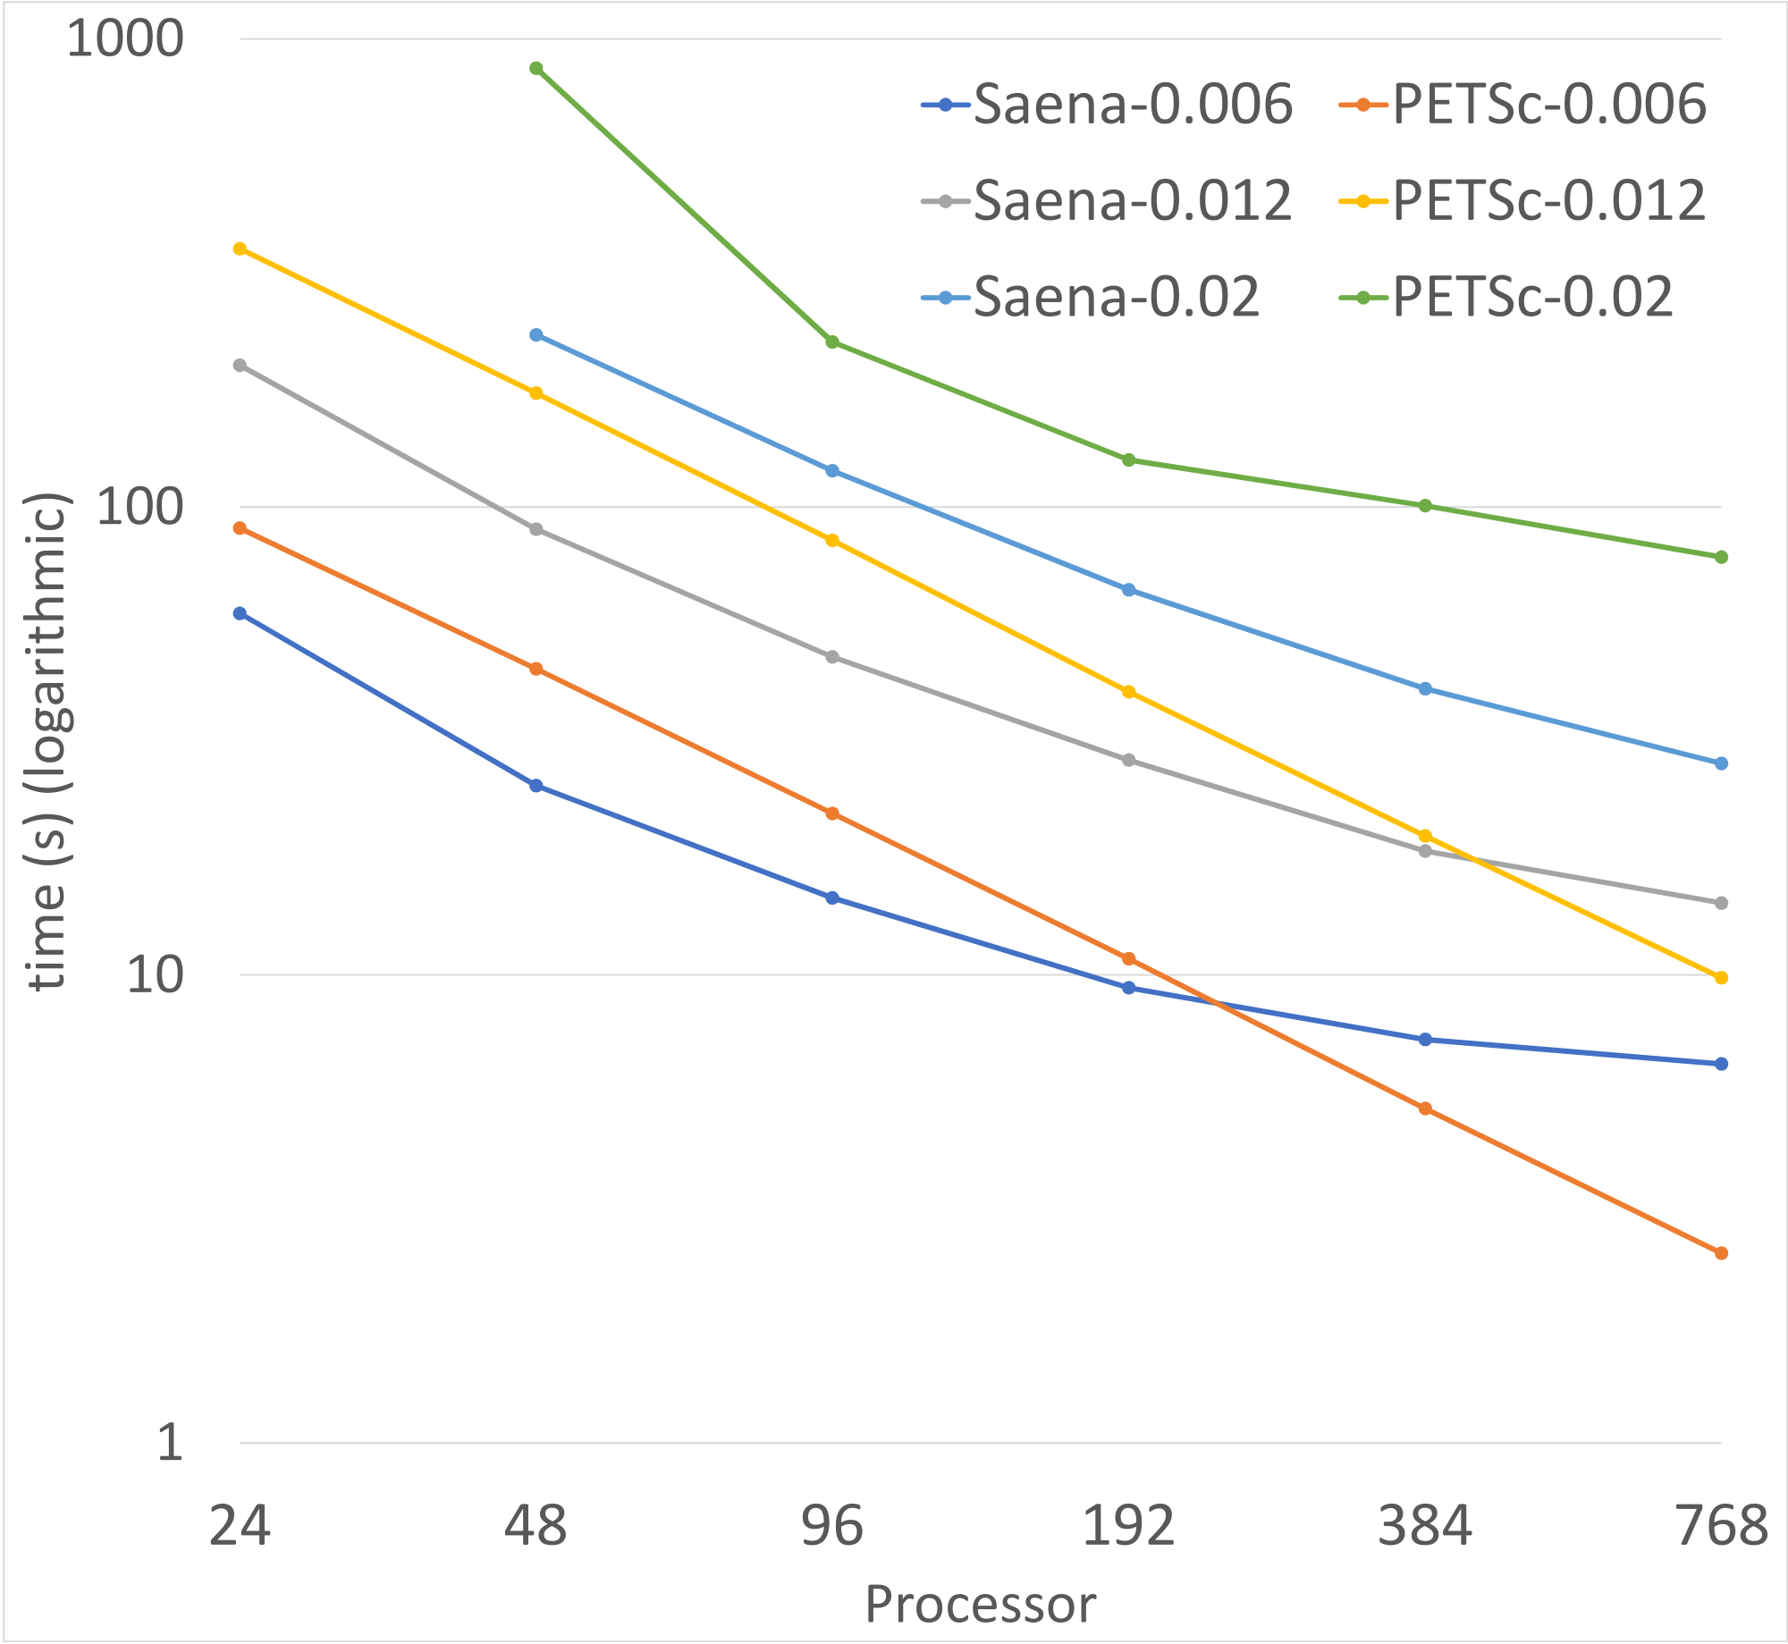
Results
Comparison of the strong scaling between our solver and PETSc.

Slide 47
Other Projects
Sparsification (short description)
Lazy-Update (short description)
Notes:
Explain when each one is better

Slide 48
Thank You

